Slide 1
Term Deposits Case Study

Slide 2
Data Exploration and Data Cleaning
Data set has total of 21 attributes of which one attribute is dependent
Data is mix of both numeric and Categorical columns
Categorical columns have unknown as value in their data , out of all the columns Default is one column where the unknows are very high and this can be treated as unknown label , similarly for job , marital , education , housing and loan
Mean age is 40 and it has some outliers as well but to reflect the real world scenario I didn’t drop the outliers
Duration highly effects the model performance hence dropped it from data set
The mean balance is higher for customers who subscribe to the term deposit compared to those who don’t

Slide 3
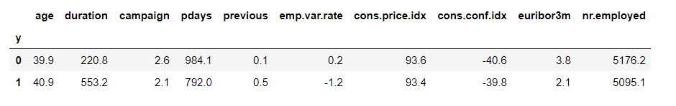
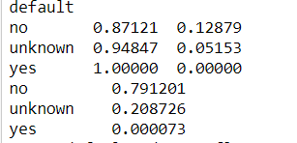
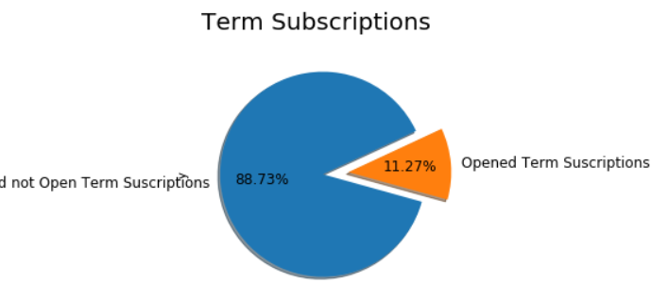
Number of days that passed by after the client was last contacted from a previous campaign is lower for people who have subscribed
Number of contacts performed before this campaign is also lower for customers who subscribe
This indicates customers with a higher balance and those who have been contacted frequently before the campaign tend to subscribe for term deposit
Since default yes is only 2 % of the data and the conversion is also comparatively lower for default – yes we can remove this column
Response rate is only 11.2 % , hence the Y variable has a class imbalance , accuracy will not be a reliable model performance measure
False Negative is very critical for this business case because a false negative is a customer who will potentially subscribe for a loan but who has been classified as will not subscribe, hence the most relevant model performance measure is recall

Slide 4
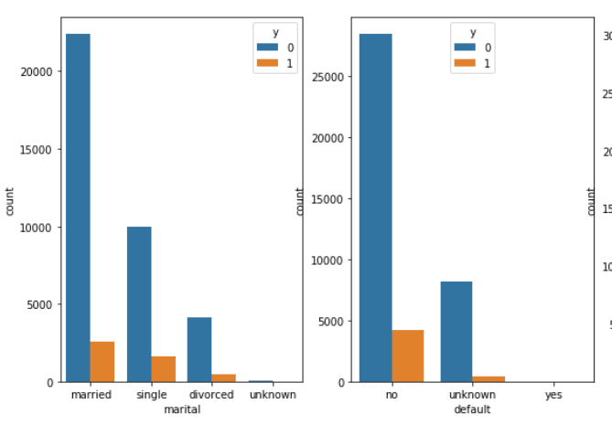
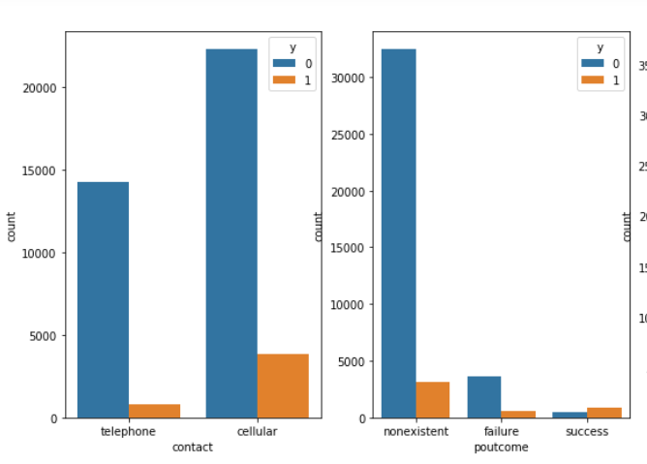
Customers who doesn’t have loans are the likeliest ones to subscribe to term deposits
Pout come is a good feature to consider for next campaign around
Married people are most likely to subscribe for term deposit
Customers who are contacted through cellular are most likely to subscribe

Slide 5
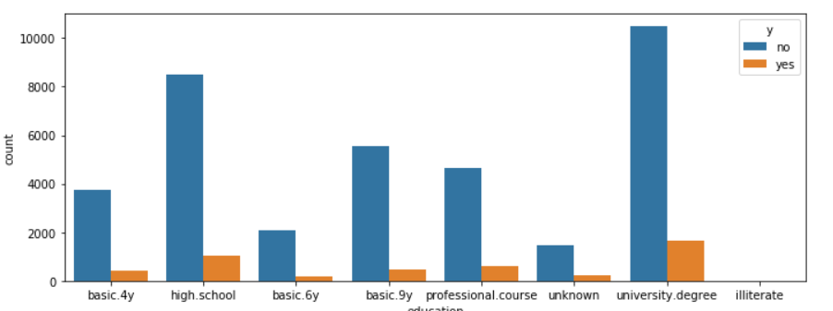
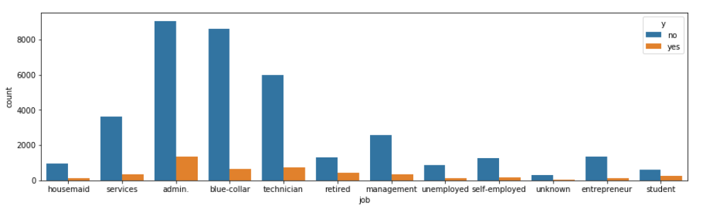
Customers who have high school degree , university degree and professional course are most likely to subscribe to term deposit
Customers who have jobs related to Admin , Blue collar , Technician , retired are more likely to subscribe

Slide 6
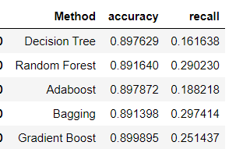
Model Building
Among numerical features , only one column ‘pdays’ had missing values as 999 , to handle this ‘pdays’ is converted to categorical feature using buckets < 5 days , 6-15 days etc.
Decision Trees
Simple to understand and effective , splits the data at every node based on one feature
Uses information gain as measure for split
Random Forest
Constructs multiple Decision trees and takes the mode of those trees for an example to make final prediction
Ada Boost
Many DT with single split are constructed
Instance which is hard to classify gets more attention by giving it a larger weight
Gradient boosting is generalized version of Ada boost
One week learner is added at a time and existing weak learners remain unchanged

Slide 7
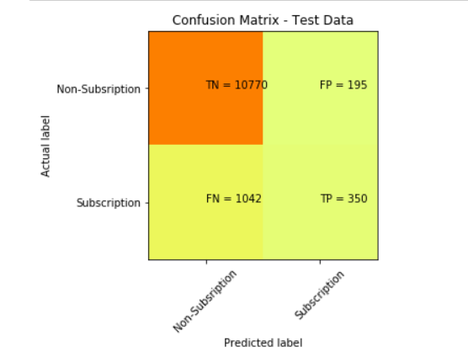
Recall: Is the total number of "Yes" in the label column of the dataset. So how many "Yes" labels does our model detect. Precision: Means how sure is the prediction of our model that the actual label is a "Yes".
Positive/Negative: Type of Class (label) ["No", "Yes"] True/False: Correctly or Incorrectly classified by the model.
True Negatives (Top-Left Square): This is the number of correctly classifications of the "No" class or potential clients that are not willing to subscribe a term deposit.
False Negatives (Bottom-Left Square): This is the number of incorrectly classifications of the Yes" class or potential clients that are not willing to subscribe a term deposits
False Positives (Top-Right Square): This is the number of incorrectly classifications of the “No" class or potential clients that are willing to subscribe a term deposit.
True Positives (Bottom-Right Square): This is the number of correctly classifications of the "Yes" class or potential clients that are willing to subscribe a term deposit.

Slide 8
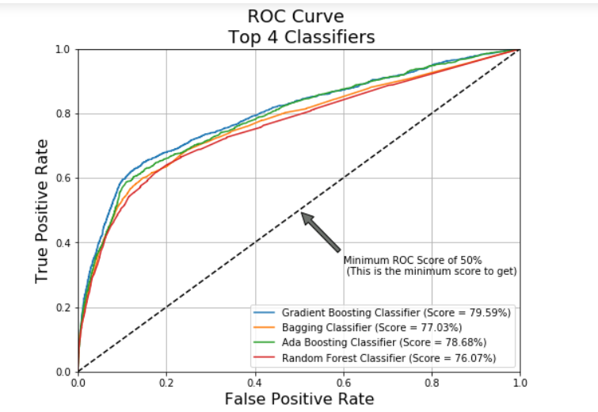
The ROC curve tells us how well our classifier is classifying between term deposit subscriptions (True Positives) and non-term deposit subscriptions. The X-axis is represented by False positive rates (Specificity) and the Y-axis is represented by the True Positive Rate (Sensitivity.) As the line moves the threshold of the classification changes giving us different values. The closer is the line to our top left corner the better is our model separating both classes.

Slide 9
Conclusion
bank should consider restricting the number of calls may be not more than 3 calls should be applied to same customer, in order to save time and effort , the more we call the same client the likely he/she will decline to open term deposit
age category is another factor that should be considered for next campaign , bank should aim at clients in their 20s or younger they have a better chance of subscribing to term deposit
another thing to be considered is occupation , potential clients include the one's with stable jobs who are in management , admin, tech support , blue caller
work on a strategy to create a question for calls , because duration of call has positive effect on term deposits , to make most of the conversation it's important to keep client engaged in the conversion by asking right questions which will help client decide whether to opt for term deposit
finally identify the clients with higher duration with the bank as there's a high likelihood that they will choose term deposit , manager should consider all of these for next marketing campaign

